Slide 1
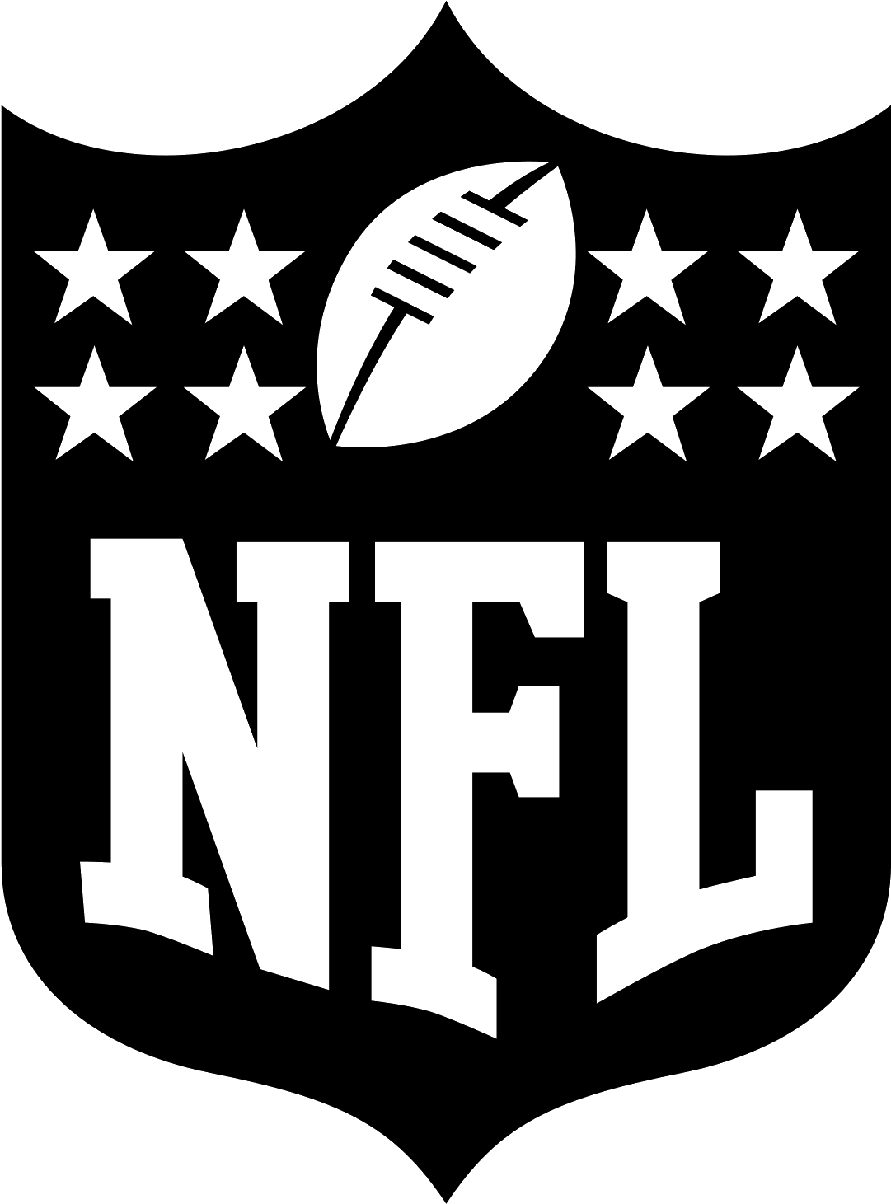
The NFL’s Role in urban crime
Sean McClellan
University of Pennsylvania Capstone

Slide 2
The relationship between sports and crime
During a sporting event, several factors change in the immediate area. These factors can heavily influence crime, both positively and negatively.
Observing variations during games at a higher elevation is something that has not been studied in nearly as much depth as crime directly around a stadium.
Various theories have been applied to the study of crime and its relationship with sporting events.
Deindividuation Theory
Large crowds and stadium atmospheres can contribute to a collective mind, which can cause individuals to lose the ability of evaluating themselves or their actions and result in irrational or irresponsible behavior.
Routine Activity Theory
Stadium parking lots during games provide rows of suitable targets without any supervision, as most vehicle owners are in the stadium. Theft from vehicles is known to increase around stadiums during major league sports matches including NFL and MLB games.

Slide 3
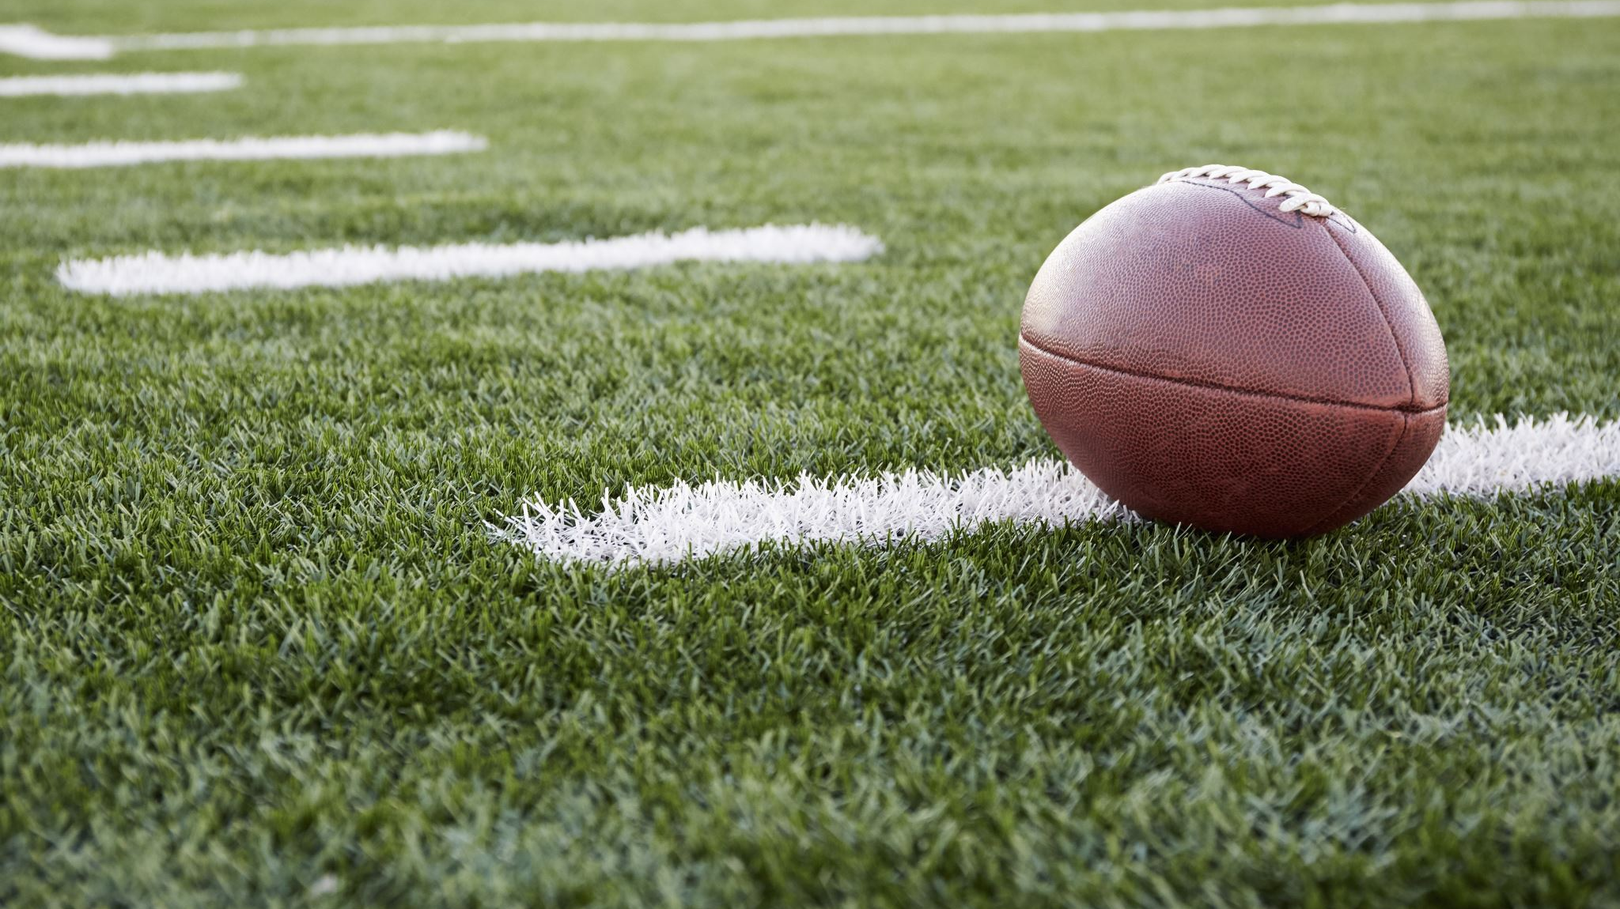
Questions
Does the location or amount of crime change on NFL gamedays?
Does crime on gamedays cluster around the stadium?
Does crime on gamedays cluster around bars?
What types of crime are most likely to increase/decrease on game days?

Slide 4
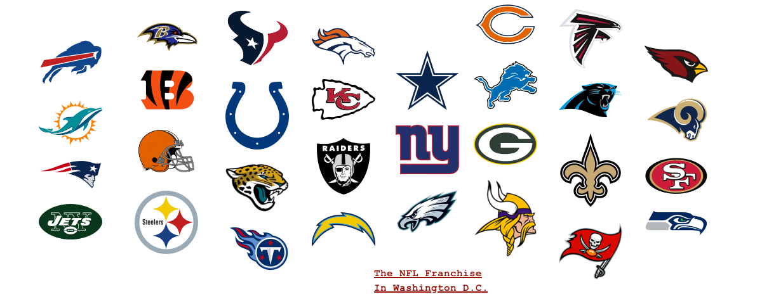
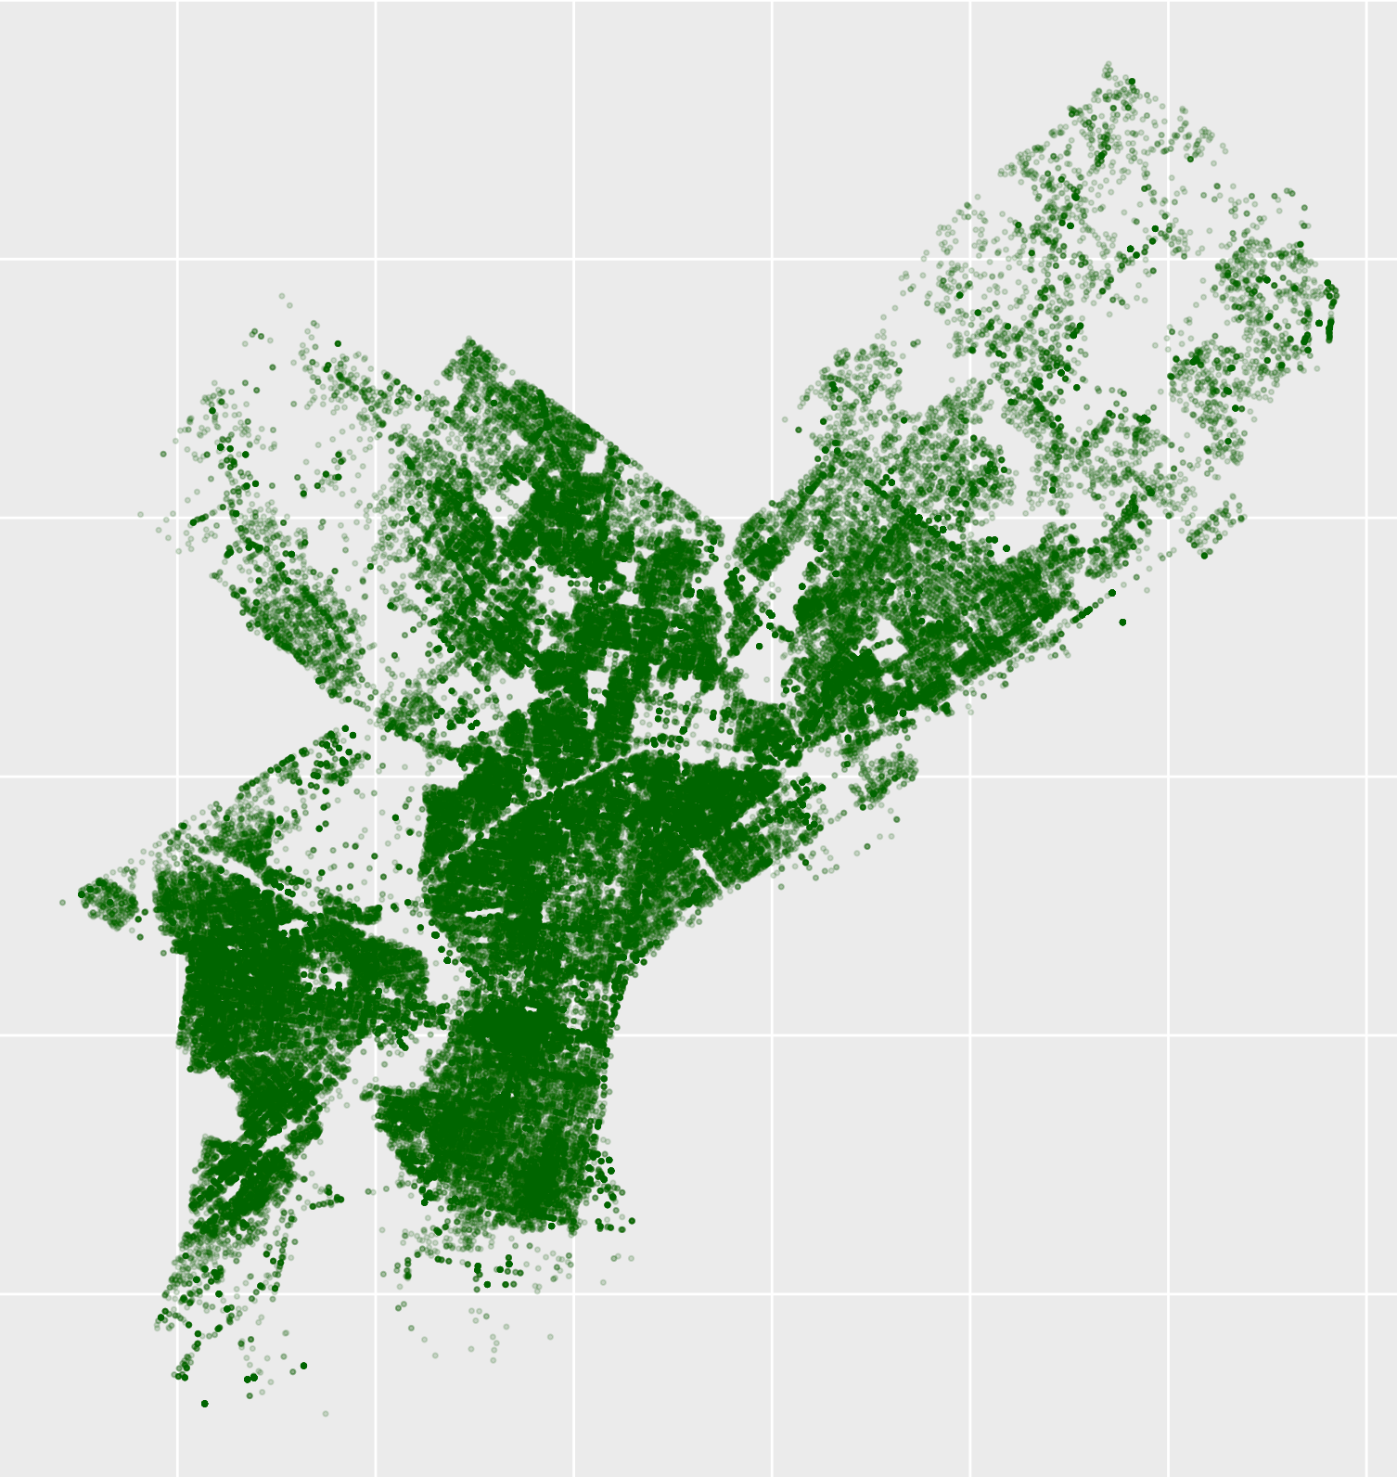
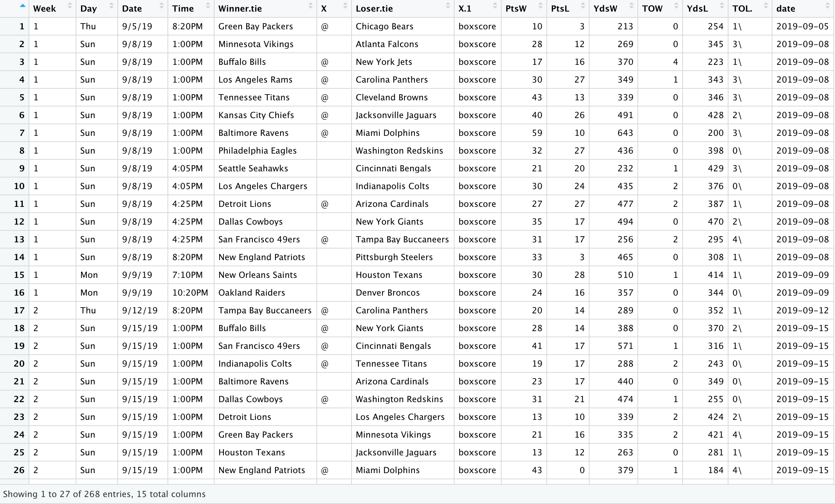
Data

Slide 5
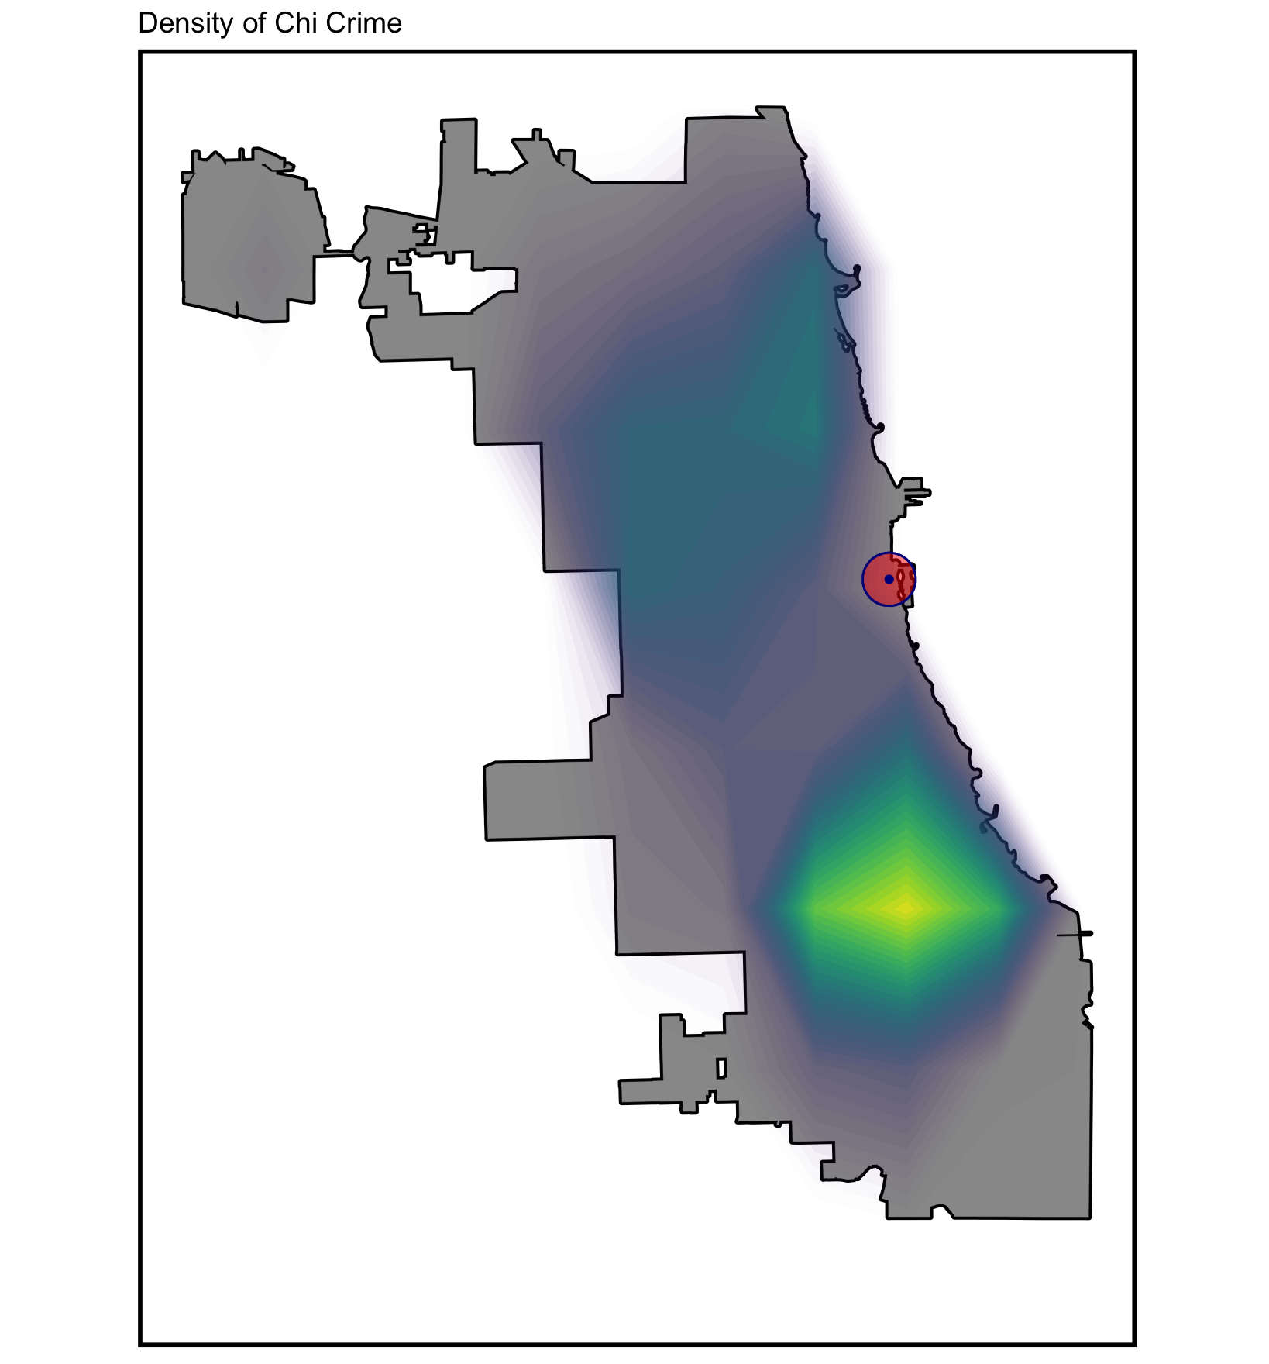
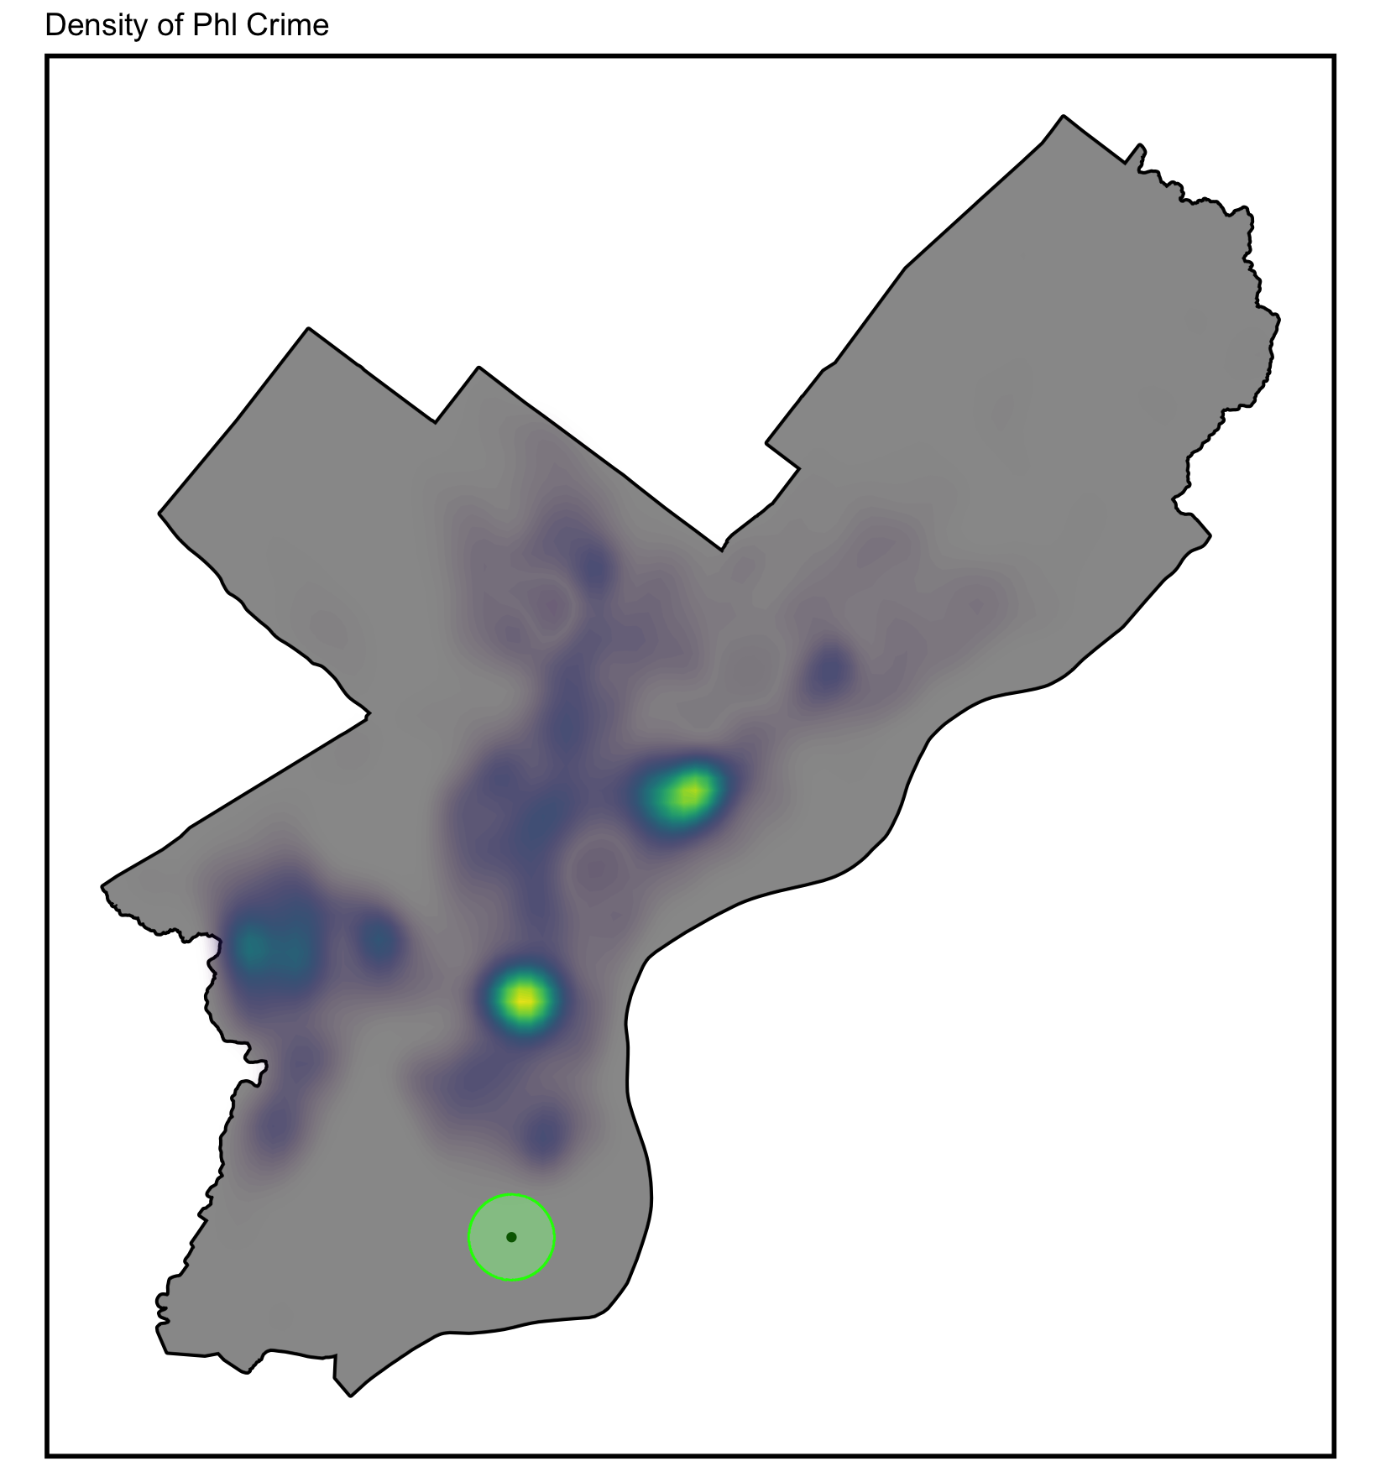
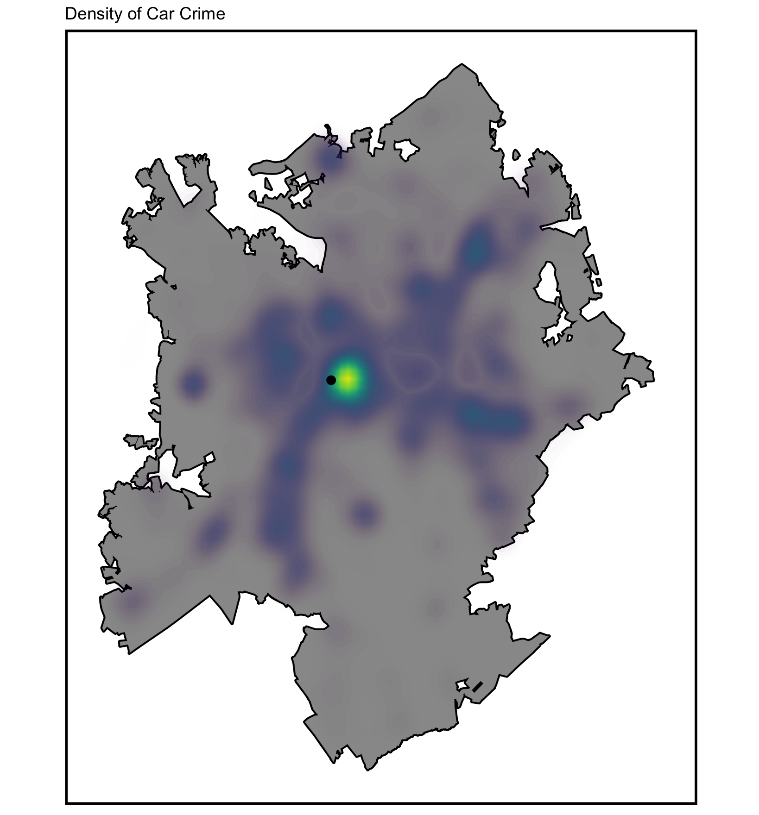
Spatial analysis

Slide 6
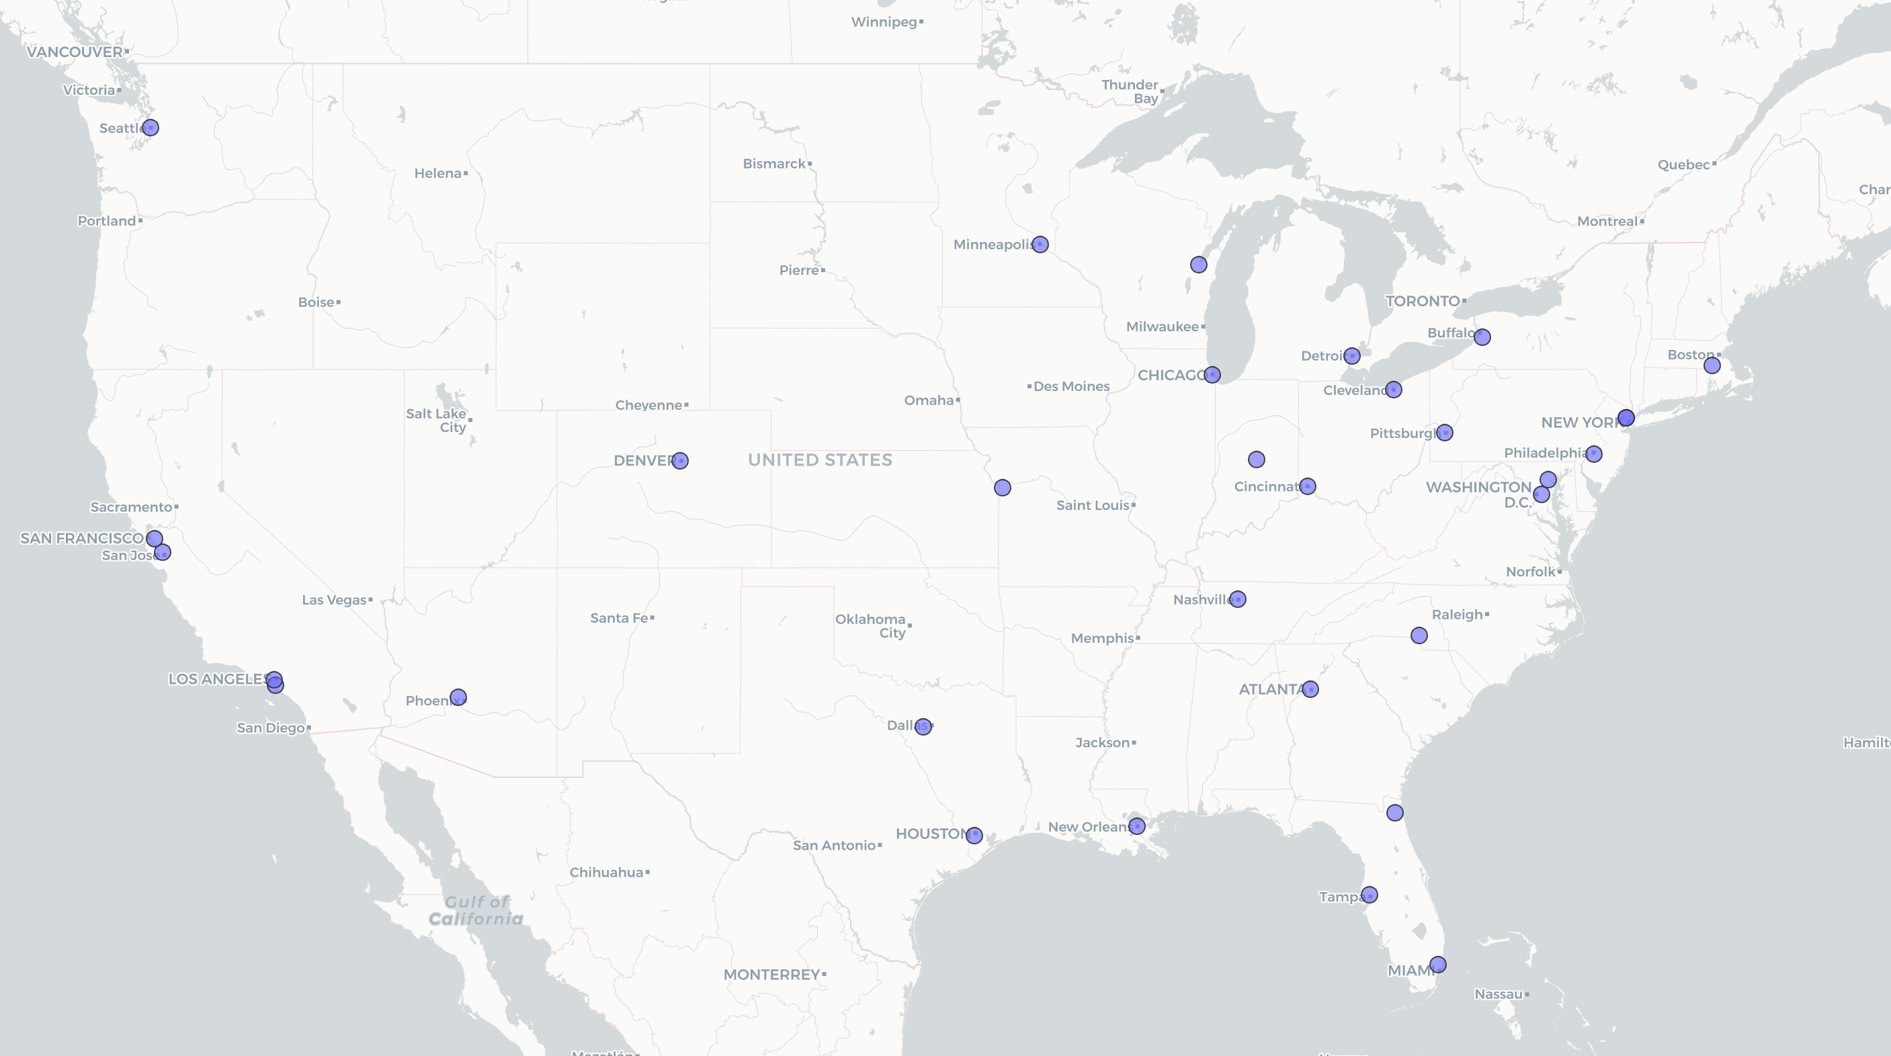
Nationwide

Slide 7
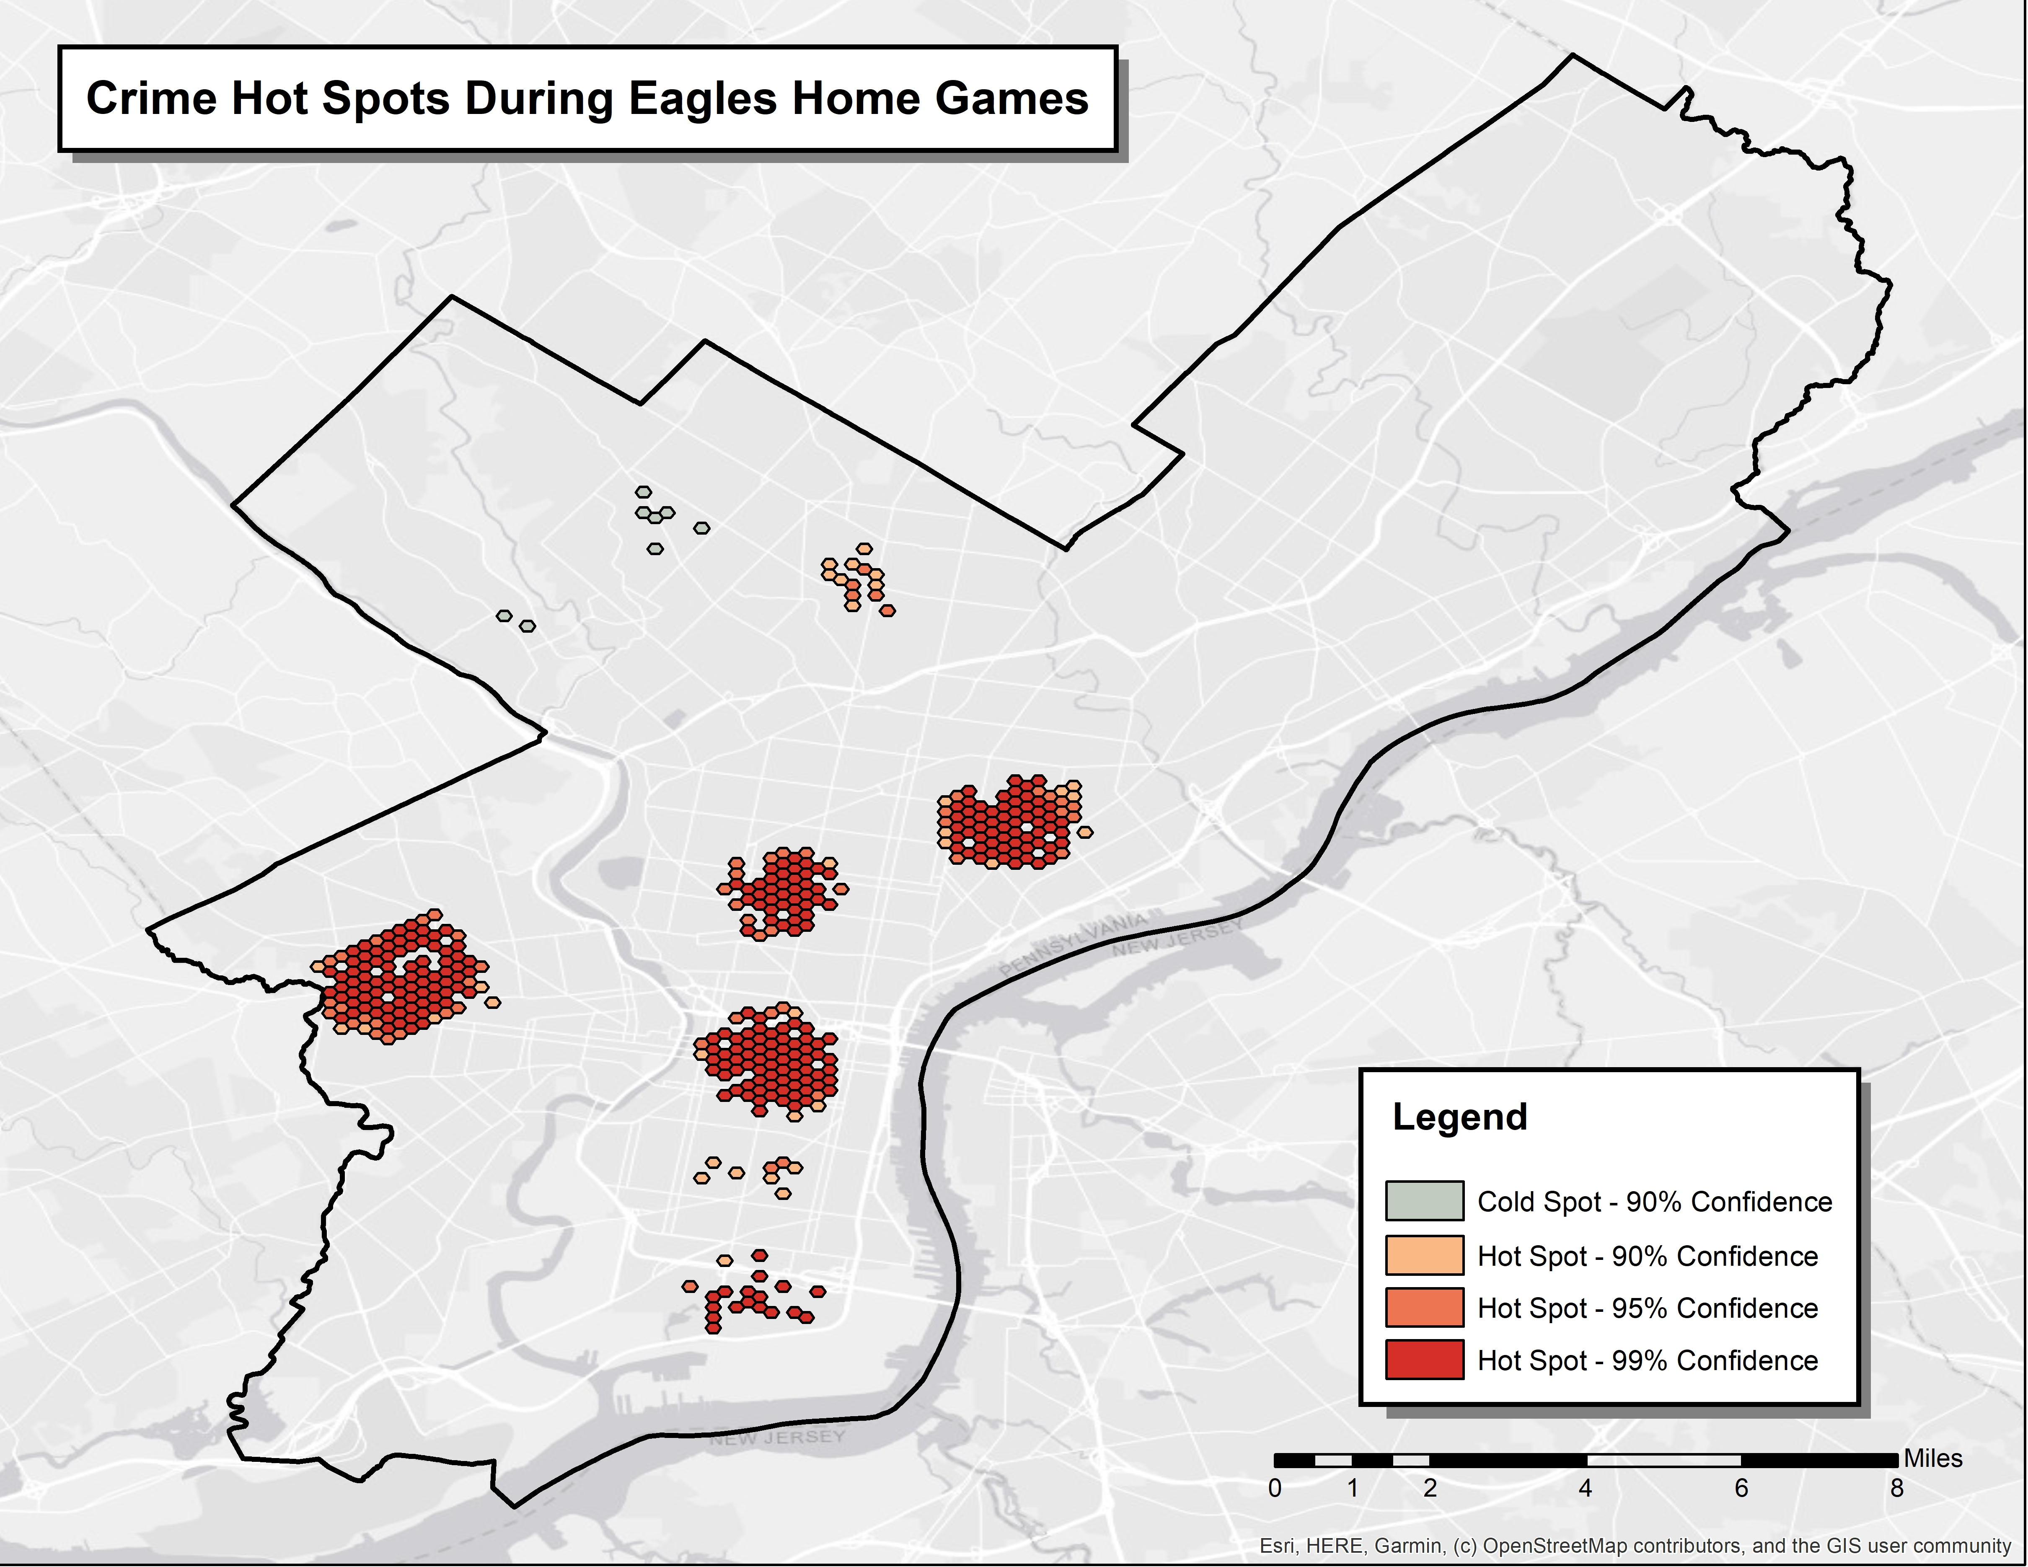
Ideas

Slide 8
Challenges to tackle
Teams that do not have crime data
Teams who have stadiums further away from their city
Joint datasets
Fishnet/hotspot vs. density

